Slide 1
Bell work: On white boards, write a reason why we may have put mustaches on our faces.

Slide 2
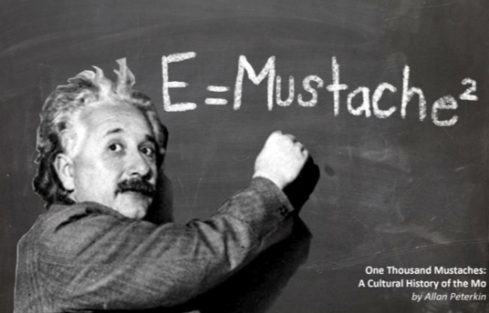
During the month of November, thousands of men across USA and the world, grow mustaches to help bring awareness to men's health, especially prostate cancer.

Slide 3
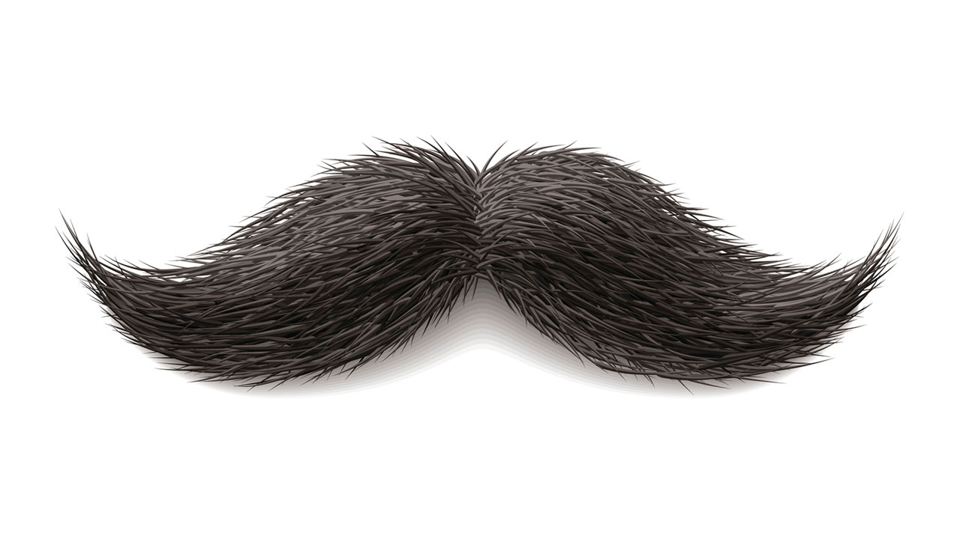
LE-A Today's goals....
Describe the importance of raising awareness
To differentiate healthy vs cancerous cells

Slide 4
1.What does pink & the blue ribbon each represent?
2. List as many things you know about the condition?
(Words, facts, assumptions, treatment, statistics, etc.)
Pink:
b. Blue:

Slide 5
Tell us what you know…
Pink
Blue

Slide 6
"When It Comes to Cancer, Men Must Act More Like Women" (Awareness)
"Did you know that breast cancer and prostate cancer are almost identical in statistics? Believe it or not, they have almost the same number of diagnoses each year and even occur at almost the exact same age in men and women. Prostate cancer is just as common in men as breast cancer is in women, with over 233,000 cases diagnosed each year."- Samadi

Slide 9
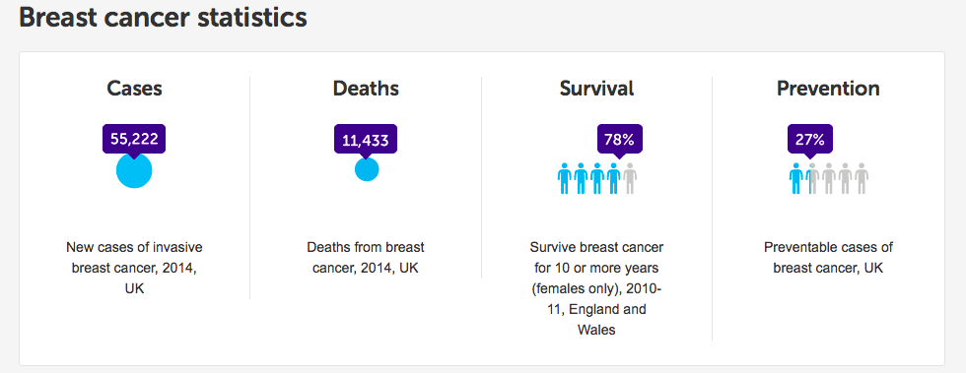

Slide 12
What Unit Are We In?

Slide 13
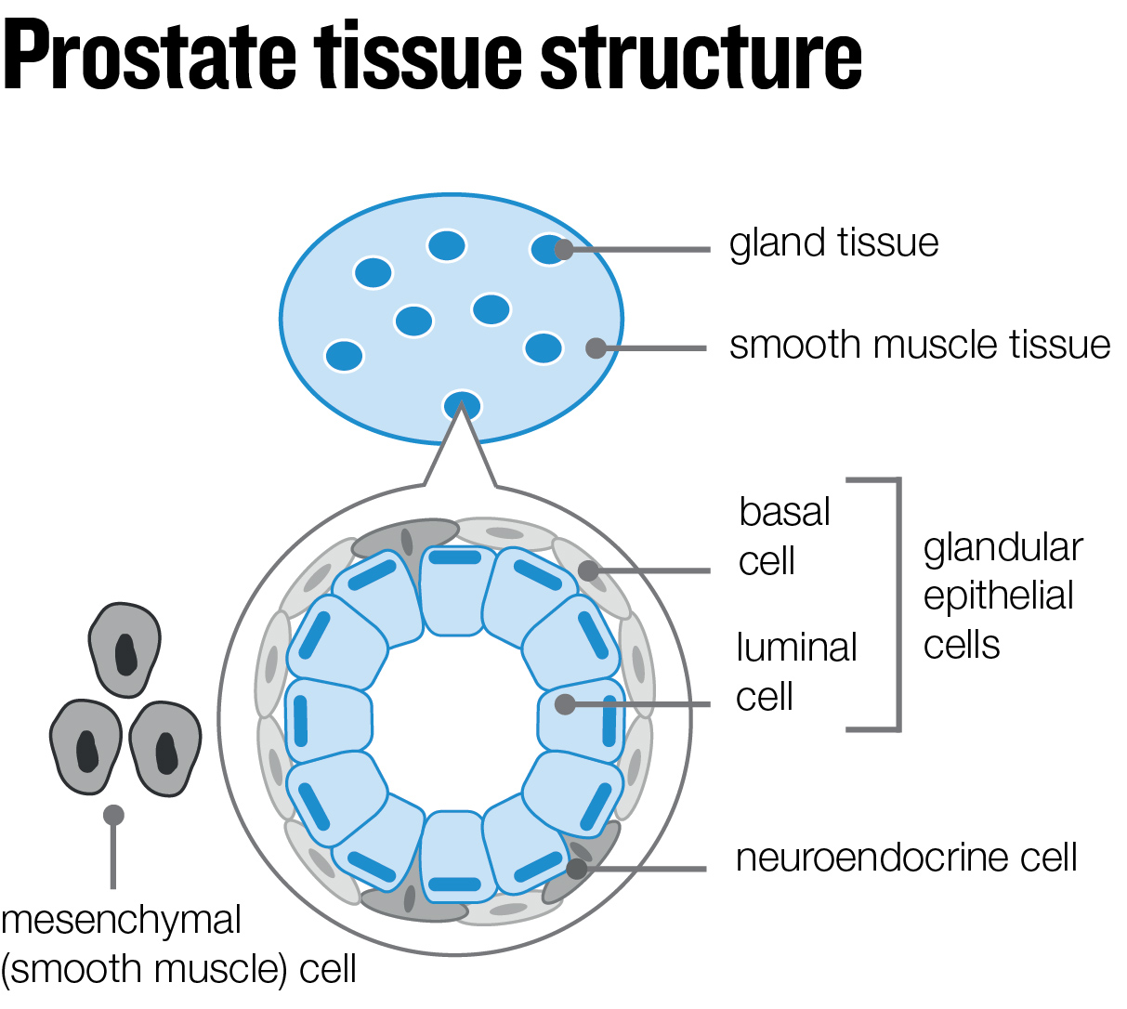

Slide 14
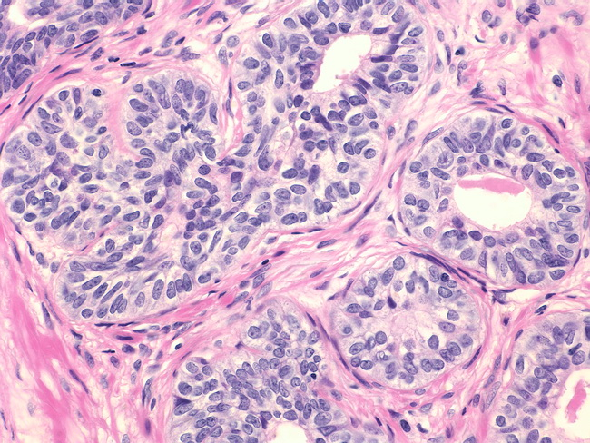

Slide 16
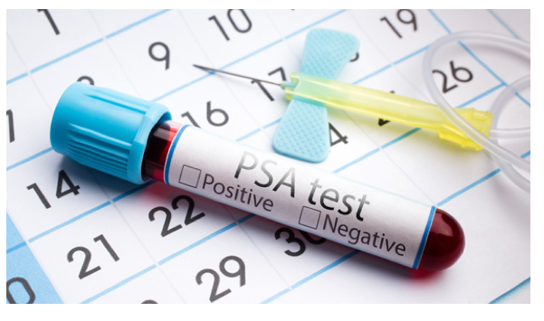
Why see a Urologist?
One may go to see a urologist for screening of:
-prostate cancer
- bladder cancer.
- bladder prolapse.
- hematuria (blood in the urine)
- erectile dysfunction (ED)
- interstitial cystitis (also called painful bladder syndrome)
- overactive bladder
- prostatitis (swelling of the prostate gland)

Slide 30
Healthy vs. Cancerous Cell Video Questions
How do our cells reproduce?
Which organelle controls cell division?
What happens if DNA undergoes a change?
How do tumors survive?
When does the tumor become dangerous?
What is metastasis?
Why does a cell become cancerous : Name 2 factors
How many people a year die from cancer?
What is the most wide spread type of cancer?
What are three types of treatment of cancer?

Slide 34
LE-A Today's goals....
Construct a cancer removing device using art, math and engineering skills.

Slide 35
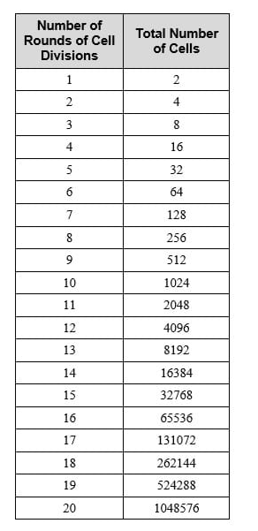

Slide 36
Why do you think that exponential growth matters when we are trying to treat cancer?

Slide 37
Earlier tumors are smaller than later tumors. If you let cancer cells divide more, the tumor size can become very large, very quickly. The smaller the tumor, the easier it is for doctors to treat and the less likely it is to spread to other parts of the body. These two factors mean that it is less likely, then, that healthy tissue will be damaged during treatment.

Slide 40
If in Trial 1, all the cancer cells are removed but fewer than 10 lentils are removed, great. (BEAT) You beat cancer! If not, the number of remaining cancer cells DOUBLES, which causes exponential growth, before Trial 2. The number of lentils stays the same. Have students fill out the worksheet with the results of each trial to keep track of numbers of cancerous and healthy cells.
Students complete additional one-minute trials of testing until either 1) all the cancer cells are removed, 2) the cancerous tumor has 100 or more cells or 3) 10 or more healthy cells are removed total (in all testing trials).
Upon winning or losing the battle against cancer, have groups modify their surgical tools to improve them. Then make the game easier or harder as required through adjusting the number of cancer cells to start. Then, start the testing procedure over with Trial 1.

Slide 41
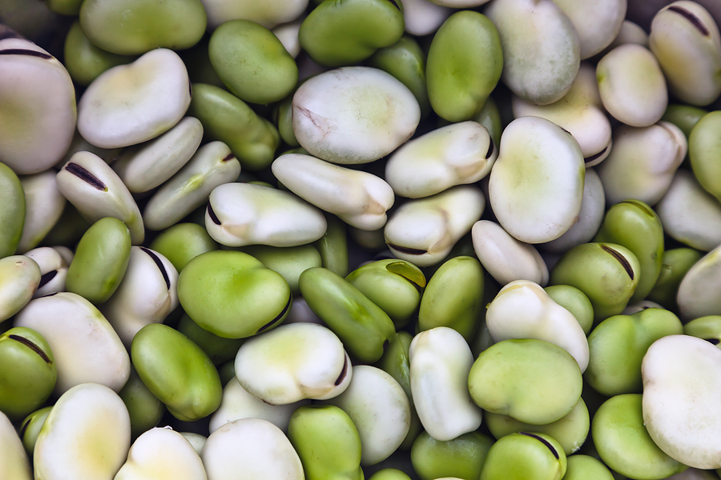
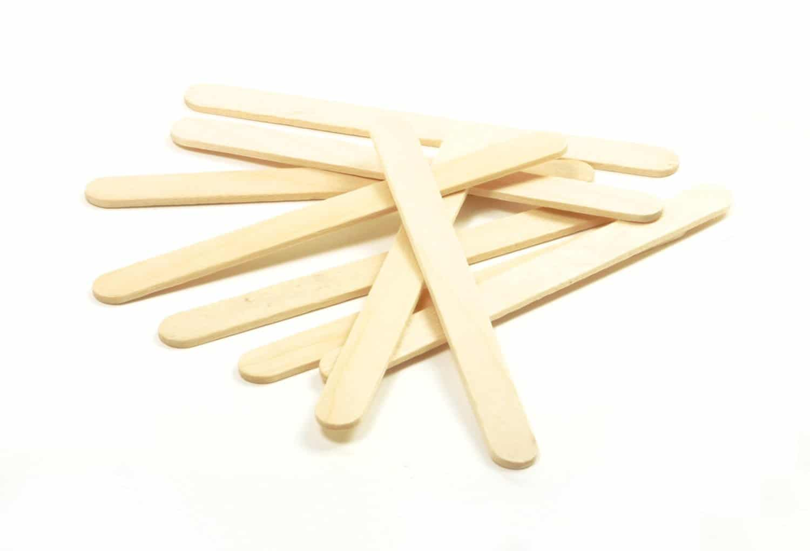
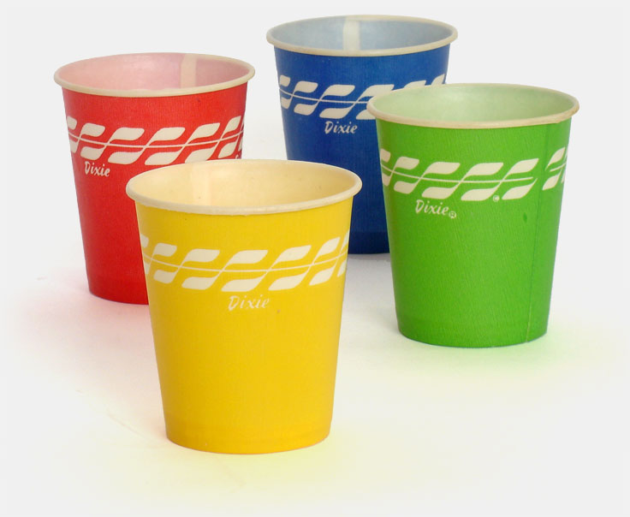
Draw a tool model

Slide 42
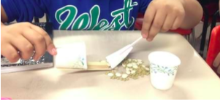
Goal…
Design a cancer removing tool!

Slide 46
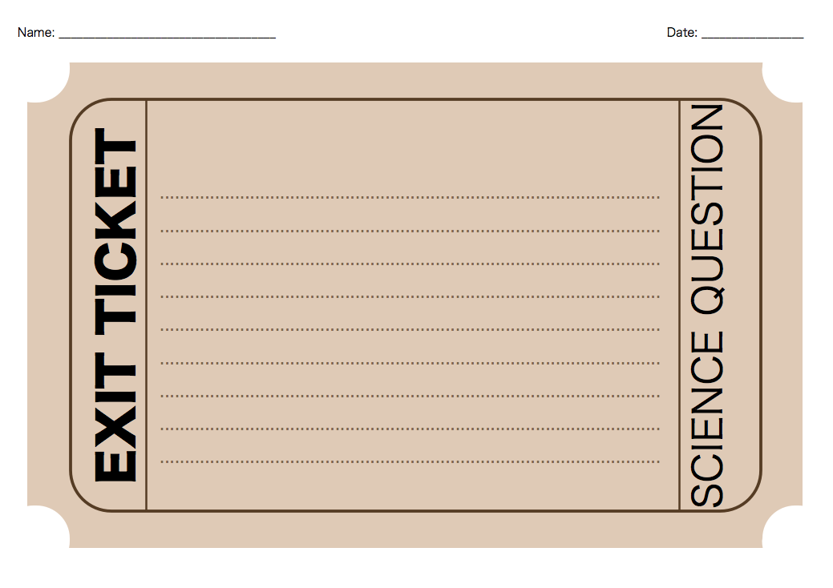
List one difference between healthy cells and cancer cells.
What cancer/condition will you design a project for? Describe your project ideas

