Slide 1
The Goat by the Water
Ms.Umile
Making Observations and Inferences

Slide 2
Define: Observation(s)
noun
The act of attentive watching, perceiving, or noticing, using our 5 senses
The data measured, collected, perceived or noticed, especially during an experiment
Notes:
The original worksheet for this activity is posted at the following link (pdf) from Project Archaeology (link).

Slide 3
Define: Inference(s)
noun
a logical conclusion based on observations
the ‘story’ or ‘guess’ about what happened or will happen
Notes:
The original worksheet for this activity is posted at the following link (pdf) from Project Archaeology (link).

Slide 4
Notes:
The original worksheet for this activity is posted at the following link (pdf) from Project Archaeology (link).

Slide 5
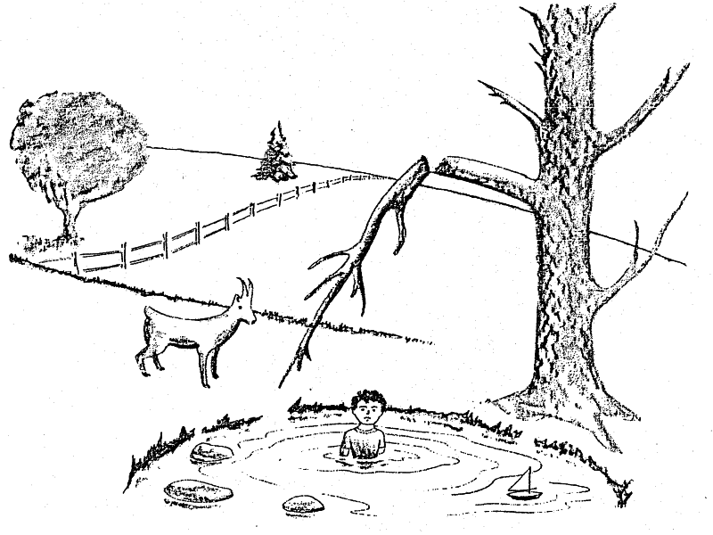
Obs or Inf?
_____ 1. The kid is in the water
_____ 2. The weather is cold
_____ 3. The tree branch is broken
_____ 4. If the kid crawled out of the water,
the goat would push him/her
_____ 5. The kid fell off the branch
Notes:
The original worksheet for this activity is posted at the following link (pdf) from Project Archaeology (link).

Slide 6
Obs or Inf?
OBS 1. The kid is in the water
2. The weather is cold
3. The tree branch is broken
4. If the kid crawled out of the water,
the goat would push him/her
5. The kid fell off the branch
Notes:
The original worksheet for this activity is posted at the following link (pdf) from Project Archaeology (link).

Slide 7
Obs or Inf?
OBS 1. The kid is in the water
INF 2. The weather is cold
3. The tree branch is broken
4. If the kid crawled out of the water,
the goat would push him/her
5. The kid fell off the branch
Notes:
The original worksheet for this activity is posted at the following link (pdf) from Project Archaeology (link).

Slide 8
Obs or Inf?
OBS 1. The kid is in the water
INF 2. The weather is cold
OBS 3. The tree branch is broken
4. If the kid crawled out of the water,
the goat would push him/her
5. The kid fell off the branch
Notes:
The original worksheet for this activity is posted at the following link (pdf) from Project Archaeology (link).

Slide 9
Obs or Inf?
OBS 1. The kid is in the water
INF 2. The weather is cold
OBS 3. The tree branch is broken
INF 4. If the kid crawled out of the water,
the goat would push him/her
5. The kid fell off the branch
Notes:
The original worksheet for this activity is posted at the following link (pdf) from Project Archaeology (link).

Slide 10
Obs or Inf?
OBS 1. The kid is in the water
INF 2. The weather is cold
OBS 3. The tree branch is broken
INF 4. If the kid crawled out of the water,
the goat would push him/her
INF 5. The kid fell off the branch
Notes:
The original worksheet for this activity is posted at the following link (pdf) from Project Archaeology (link).

Slide 11
Obs or Inf?
___ 6. The goat is standing by the pond
___ 7. The branch will fall on the kid’s head
___ 8. The kid fell off the rocks
___ 9. There is a sailboat in the water
___ 10. The sailboat belongs to the kid
Notes:
The original worksheet for this activity is posted at the following link (pdf) from Project Archaeology (link).

Slide 12
Obs or Inf?
OBS 6. The goat is standing by the pond
7. The branch will fall on the kid’s head
8. The kid fell off the rocks
9. There is a sailboat in the water
10. The sailboat belongs to the kid
Notes:
The original worksheet for this activity is posted at the following link (pdf) from Project Archaeology (link).

Slide 13
Obs or Inf?
OBS 6. The goat is standing by the pond
INF 7. The branch will fall on the kid’s head
8. The kid fell off the rocks
9. There is a sailboat in the water
10. The sailboat belongs to the kid
Notes:
The original worksheet for this activity is posted at the following link (pdf) from Project Archaeology (link).

Slide 14
Obs or Inf?
OBS 6. The goat is standing by the pond
INF 7. The branch will fall on the kid’s head
INF 8. The kid fell off the rocks
9. There is a sailboat in the water
10. The sailboat belongs to the kid
Notes:
The original worksheet for this activity is posted at the following link (pdf) from Project Archaeology (link).

Slide 15
Obs or Inf?
OBS 6. The goat is standing by the pond
INF 7. The branch will fall on the kid’s head
INF 8. The kid fell off the rocks
OBS 9. There is a sailboat in the water
10. The sailboat belongs to the kid
Notes:
The original worksheet for this activity is posted at the following link (pdf) from Project Archaeology (link).

Slide 16
Obs or Inf?
OBS 6. The goat is standing by the pond
INF 7. The branch will fall on the kid’s head
INF 8. The kid fell off the rocks
OBS 9. There is a sailboat in the water
INF 10. The sailboat belongs to the kid
Notes:
The original worksheet for this activity is posted at the following link (pdf) from Project Archaeology (link).

Slide 17
Obs or Inf?
___ 11. The goat will soon leave the pond
___ 12. The tree by the pond has no leaves
___ 13. There are three rocks in the pond
___ 14. The tree by the pond is dead
___ 15. If it rains, leaves will grow on the tree
___ 16. The goat pushed the kid into the pond
Notes:
The original worksheet for this activity is posted at the following link (pdf) from Project Archaeology (link).

Slide 18
Obs or Inf?
INF 11. The goat will soon leave the pond
12. The tree by the pond has no leaves
13. There are three rocks in the pond
14. The tree by the pond is dead
15. If it rains, leaves will grow on the tree
16. The goat pushed the kid into the pond
Notes:
The original worksheet for this activity is posted at the following link (pdf) from Project Archaeology (link).

Slide 19
Obs or Inf?
INF 11. The goat will soon leave the pond
OBS 12. The tree by the pond has no leaves
13. There are three rocks in the pond
14. The tree by the pond is dead
15. If it rains, leaves will grow on the tree
16. The goat pushed the kid into the pond
Notes:
The original worksheet for this activity is posted at the following link (pdf) from Project Archaeology (link).

Slide 20
Obs or Inf?
INF 11. The goat will soon leave the pond
OBS 12. The tree by the pond has no leaves
OBS 13. There are three rocks in the pond
14. The tree by the pond is dead
15. If it rains, leaves will grow on the tree
16. The goat pushed the kid into the pond
Notes:
The original worksheet for this activity is posted at the following link (pdf) from Project Archaeology (link).

Slide 21
Obs or Inf?
INF 11. The goat will soon leave the pond
OBS 12. The tree by the pond has no leaves
OBS 13. There are three rocks in the pond
INF 14. The tree by the pond is dead
15. If it rains, leaves will grow on the tree
16. The goat pushed the kid into the pond
Notes:
The original worksheet for this activity is posted at the following link (pdf) from Project Archaeology (link).

Slide 22
Obs or Inf?
INF 11. The goat will soon leave the pond
OBS 12. The tree by the pond has no leaves
OBS 13. There are three rocks in the pond
INF 14. The tree by the pond is dead
INF 15. If it rains, leaves will grow on the tree
16. The goat pushed the kid into the pond
Notes:
The original worksheet for this activity is posted at the following link (pdf) from Project Archaeology (link).

Slide 23
Obs or Inf?
INF 11. The goat will soon leave the pond
OBS 12. The tree by the pond has no leaves
OBS 13. There are three rocks in the pond
INF 14. The tree by the pond is dead
INF 15. If it rains, leaves will grow on the tree
INF 16. The goat pushed the kid into the pond
Notes:
The original worksheet for this activity is posted at the following link (pdf) from Project Archaeology (link).

Slide 24
Make your own inference

